Slide 1

Ethereum blockchain concept

Slide 2
Overview : Bitcoin and existing concept
Bitcoin - A state transition system
APPLY(S, Tx) -> S’
S (State) : UTXO i.e unspent transaction o/p => [value, address]
Tx (Transaction) : One or more i/p (each,reference to existing UTXO and signature)
S’ (New State) : state with all i/p UTXO removed and new o/p UTXO added

Slide 3
Centralize to Decentralize
State Transition System + Consensys System
Consensus required, in order to ensure everyone in the network agrees on order of transaction.
No single entity can take decision
Network has to come to an agreement

Slide 4
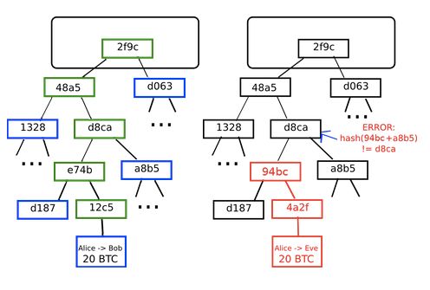
Merkle Tree
Block is stored in multilevel DS
Hash of block is the hash of block header (previous hash + nounce + timestamp + Root hash)
Merkle Tree is a type of binary tree in which each leaf node is the hash the data and each non-leaf is hash of its children and which ultimately results to a single parent node called Root hash.
Helpful because it allows miners to verify Tx without downloading whole blockchain.

Slide 5
Ethereum
Distributed - Decentralized permission less public blockchain.
Platform to build Dapps
Blockchain with Turing Complete language

Slide 6
Bitcoin Vs Ethereum
Distributed data storage
Non turing complete
Blocktime of 10 mins
Block rewards decreases every 4 years
Tracking ownership of digital currency.
Tx. fee based on size
Distributed data storage + Computation
Turing complete
Blocktime 14-15 sec
Same block rewards every year
Focused on running prog. Code on of any Dapp
Tx. fee based on contract code complexity

Slide 7
Accounts in Ethereum
What are accounts why they needed?
To maintain state
20 bytes
Types of accounts?
EOA and CA
Why there are two types ? why not only EOA
EOA
Externally owned account
Controlled by private key
Have balance
CA
Contract account
Controlled by code
Have both balance and storage for code

Slide 8
Ether and Gas
Ether : Digital currency in Ethereum network
Wei :
Smallest using of ether.
1 ether = 10^18 Wei
Gas :
Cost of network resource / utilization.
Every operation (OPCODE) is associated with a number called Gas
Principle behind Gas is to have stable value for how much a transaction.

Slide 9

Gas - Why?
Look at this piece of code:
If i=0 then it will execute for 1000 times
It has to be executed in all the miners machines
They will spend their resource and time
Hence Gas, execution cost paid by caller to miner
Why in Gas not in Ether?

Slide 10
Gas Terms
Gas Limit : Maximum amount of Gas willing to spend on Tx.
Gas cost : Static value associated with OPCODES
Gas Price : Amount of ether, user pays per gas - dynamic
Gas fee: (Gas Cost * Gas Price)

Slide 11
EVM - Ethereum Virtual Machine
Stack Based virtual machine
Ships with Ethereum clients like Geth
Consists of Stack and Store/Memory
Implementation
go-ethereum
parity
cpp-ethereum
py-EVM

Slide 12
Compiler
solc is a compiler which compiles .sol files, written in c++
Install : http://solidity.readthedocs.io/en/v0.4.21/installing-solidity.html
Usage : solc [option] [input files]
Ex. solc --bin test.sol

Slide 13
Wallets & Remix
Wallets
Metamask - Extension
Mist - Desktop Wallet
MyEthereumWallet - Web based
Remix

Slide 14
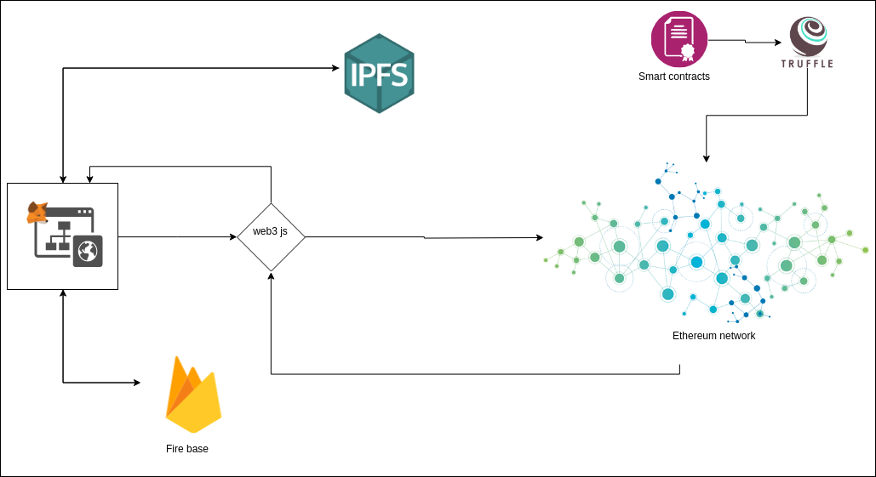
DApp - Decentralized applications

Slide 15
References
Ethereum White Paper
Ethereum yellow paper
Centralize, Decentralize, Distributed
EVM
Ethereum architecture
How to use Metamask
Mist Wallet Demo
Remix

